Slide 1
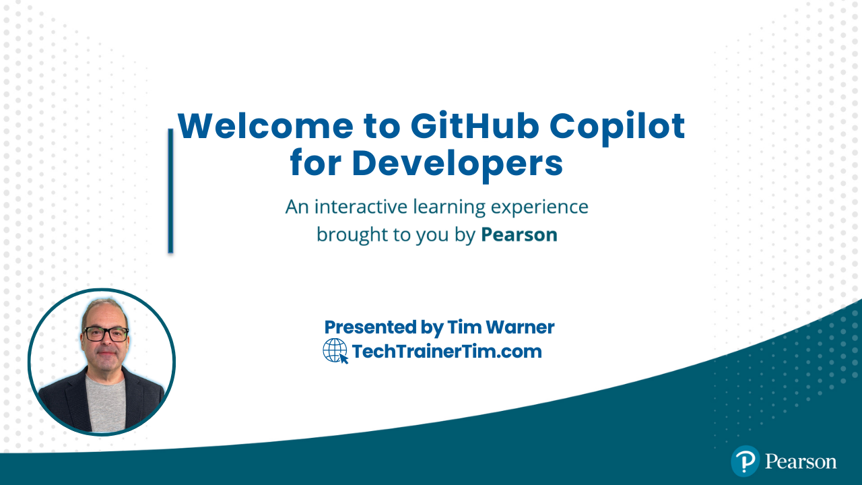



GitHub Copilot for Developers
Tim Warner
Principal Author, Pluralsight
timw.info | azureopenai.blog

Slide 2
Break Schedule (Central time)
09:00 AM - Start – Segment 1 [Enablement; RAI; Completions]
10:00 AM - 10 min break – Segment 2 [Chat Modes; CI; KB]
11:00 AM - 10 min break – Segment 3 [Governance; Privacy; Metrics]
12:00 PM - 10 min break – Segment 4 [MCP; Integrations; Future]
01:00 PM - Finish

Slide 3
Session Materials
timw.info/copilot-dev

Slide 4
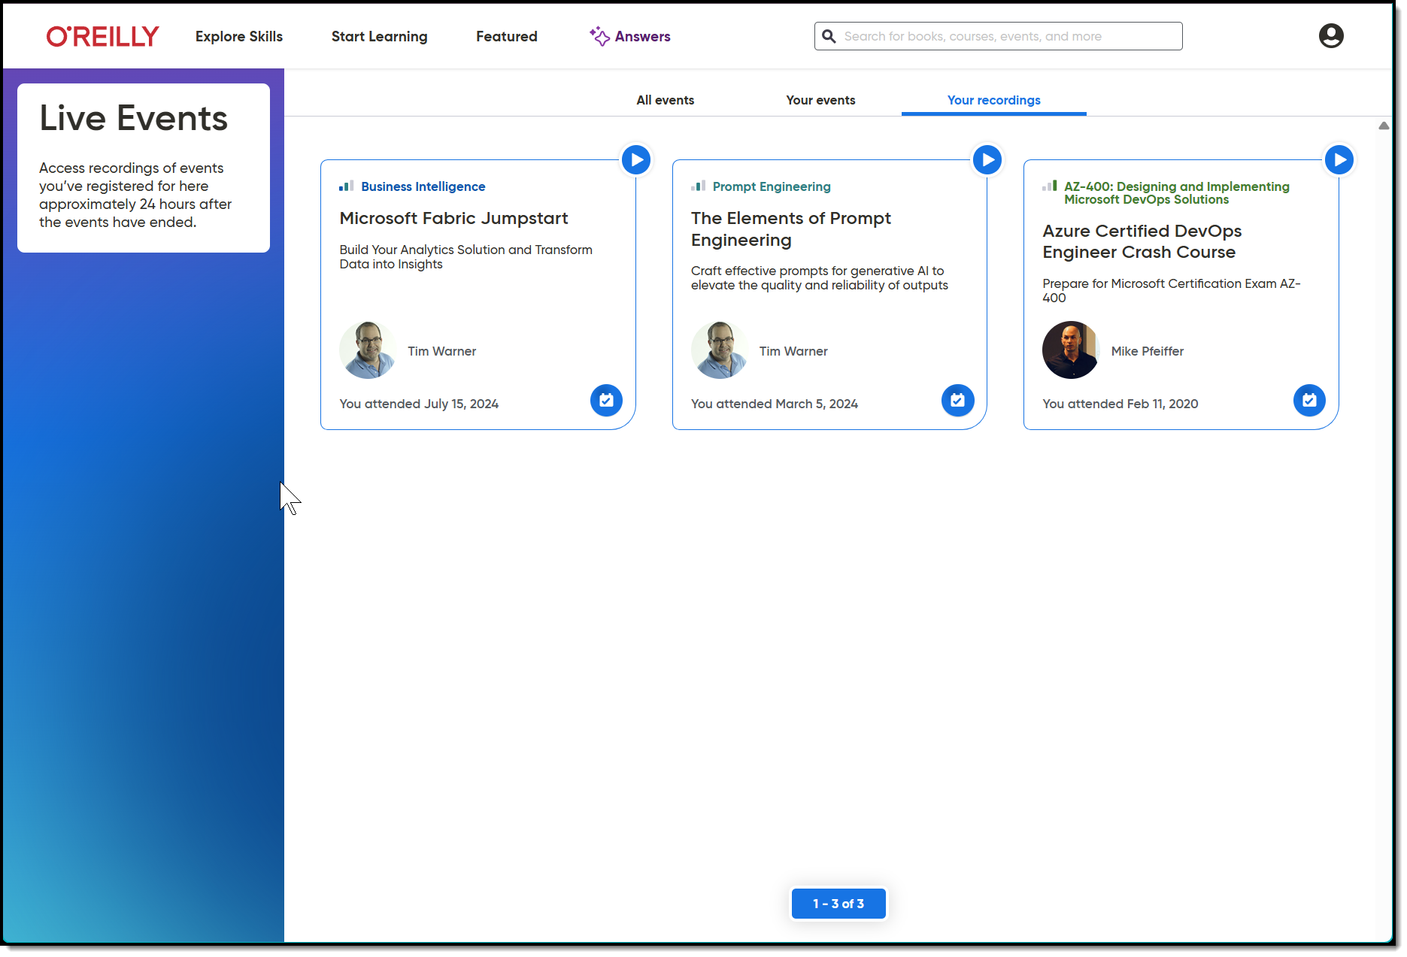
Session Recording + Badge

Slide 5
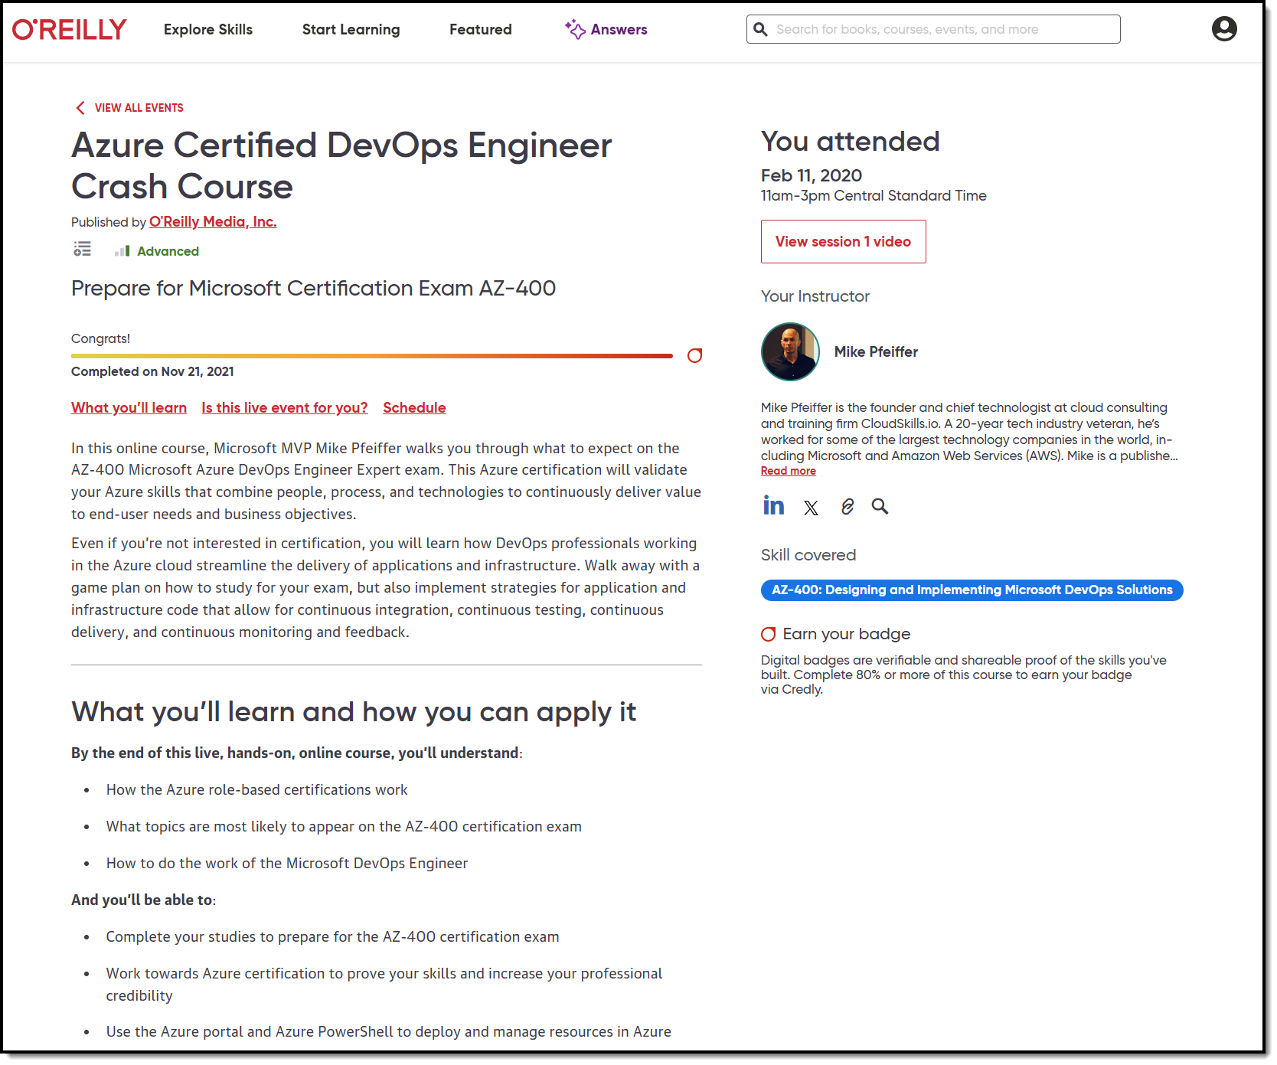
Session Recording + Badge

Slide 6
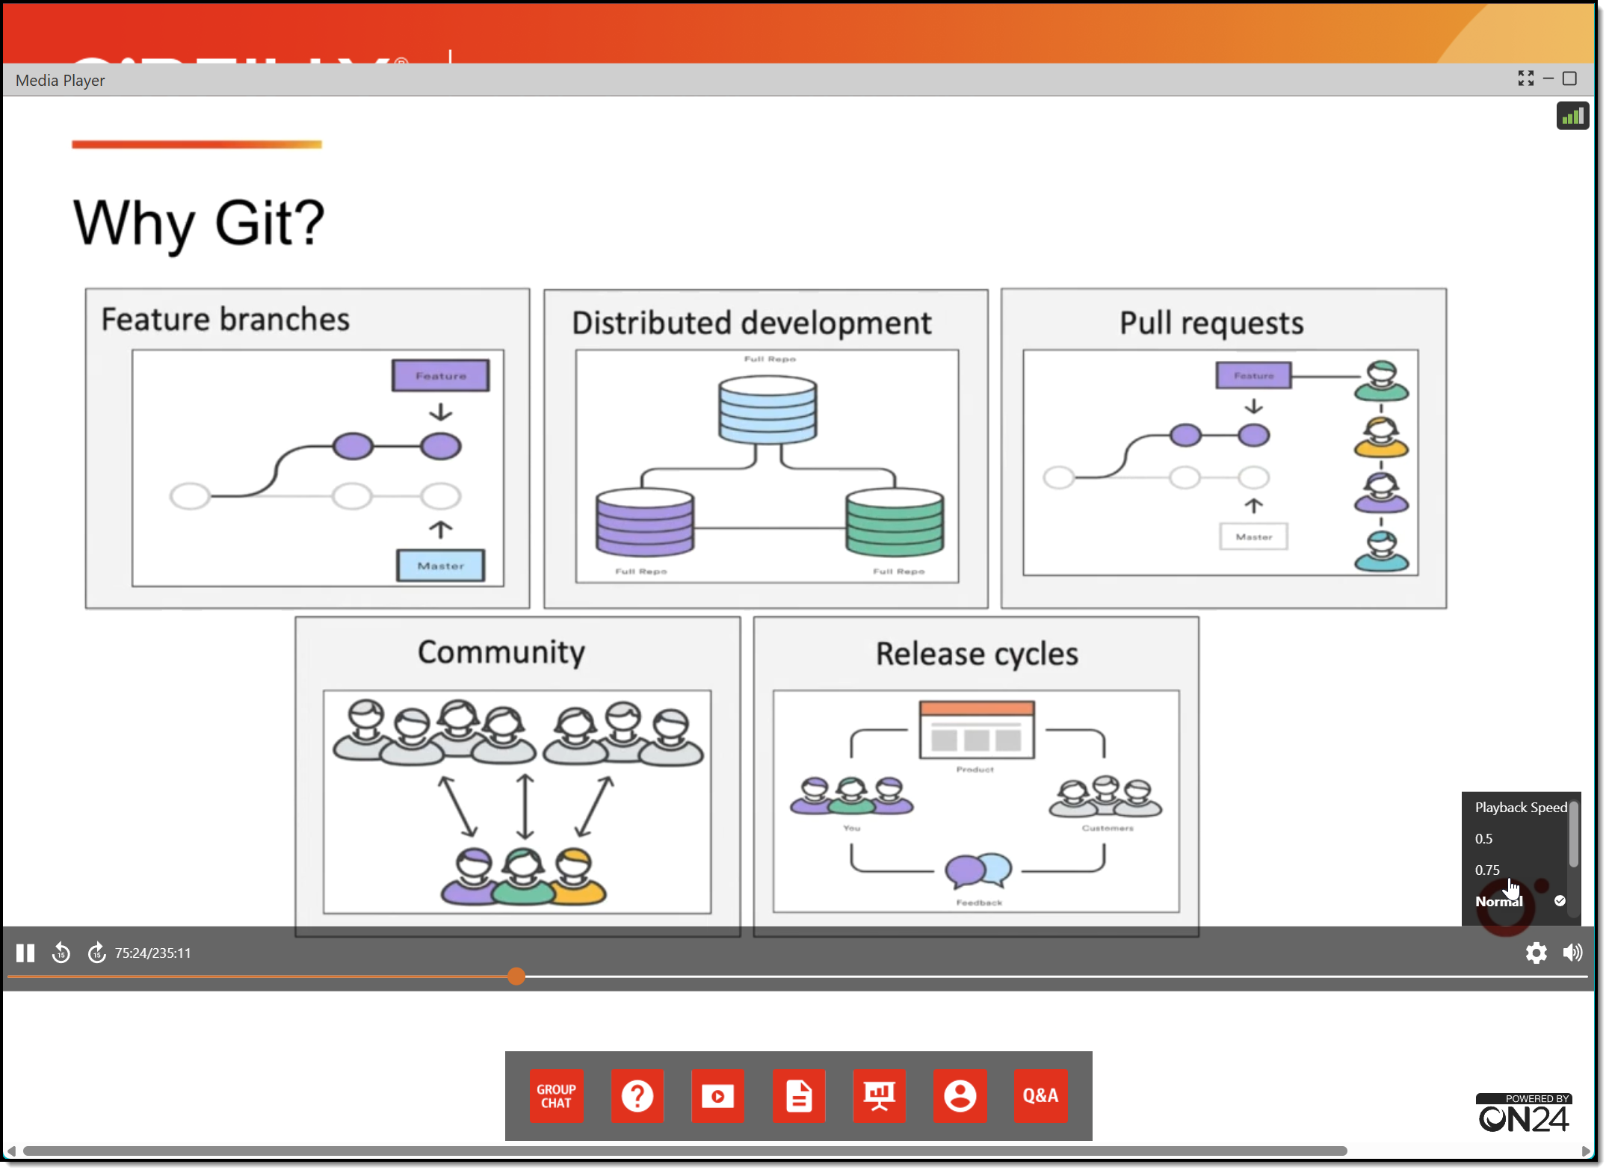
Session Recording + Badge

Slide 7
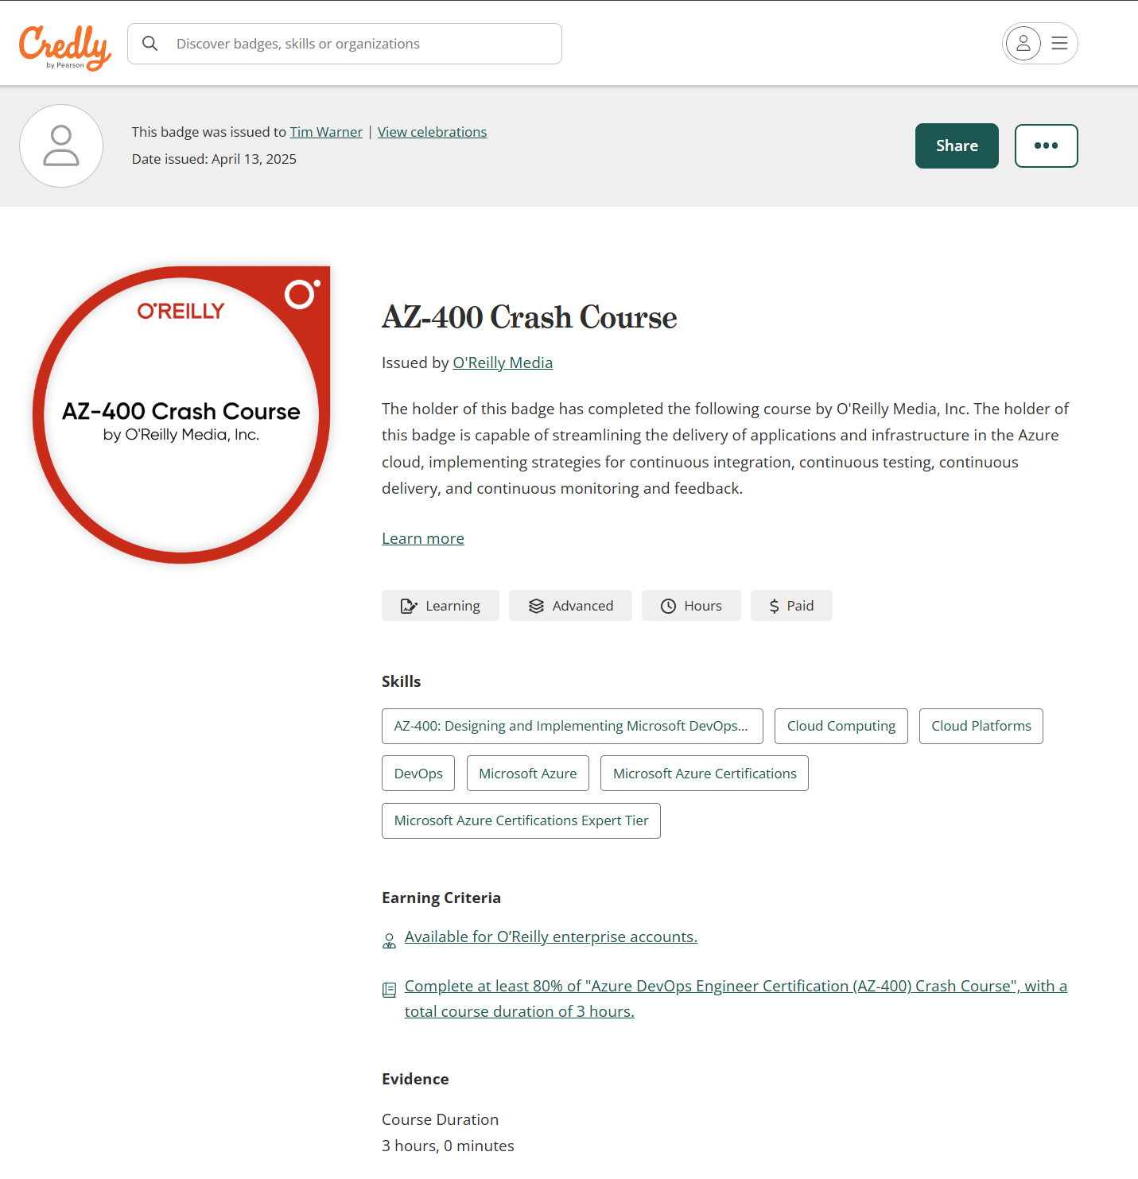
Session Recording + Badge

Slide 8
Let’s Get to Work!

Slide 9



Keeping an LLM on task be like…

Slide 10
Wrap-up

Slide 11
Tim’s 2025 Generative AI Forecast
Listen to Sam Altman’s January speech on Operator
Agentic AI
Giving the LLM additional permissions to act autonomously
Multi-source notebook LLMs (Google Notebook LM)
Developers will show themselves by their skills
Reread <<

Slide 12
Tim’s Own Future of Software Development
Directing code generation rather than writing
We’ll (likely) always have a human-in-the-middle somewhere
Instruct the AI to teach YOU how to do the work yourself
Always know your auth context with LLMs
Master GitHub API and use VS Code
Stay grounded in Responsible AI principles

Slide 13
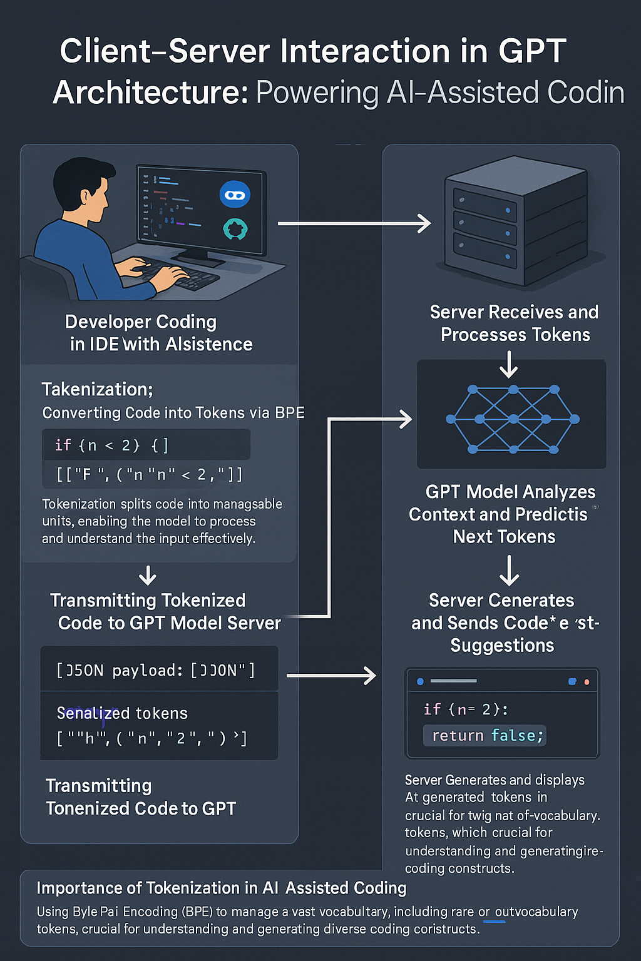
GPT Basic Architecture
OpenAI GPT 4o Image Generation
Multimodal generative AI
Two ways to improve model:
Fine tuning
Retrieval Augmented Generation (RAG)

Slide 14

Neural Network
go.techtrainertim.com/cloud

Slide 15

Context Length

Slide 16
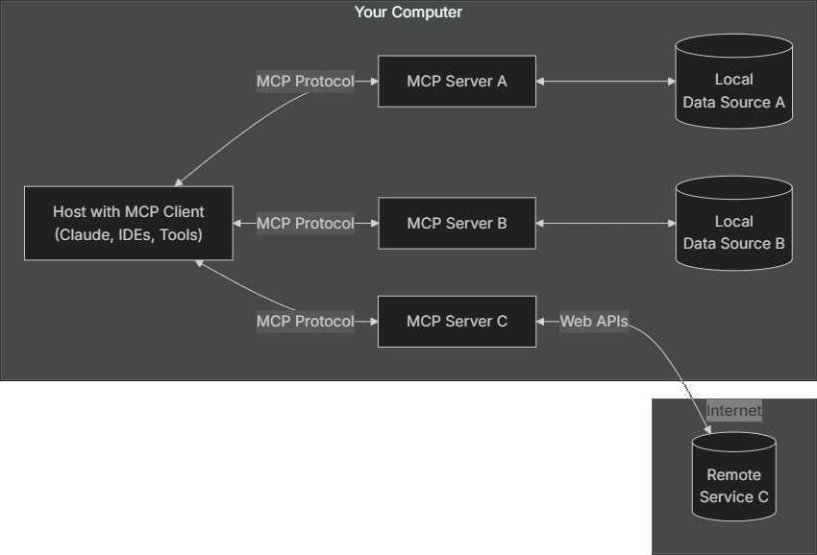
Model Context Protocol (MCP) by Anthropic
modelcontextprotocol.io

Slide 17
Thanks!
Session materials: timw.info/copilot-dev
Web: techtrainertim.com
Summary

